Slide 1
Jio Code Internship 2023-24 Review
Siddharth Verma

Slide 2
Learning Timeline
Trained a neural network for regression analysis on a “Car Price” dataset without using built-in libraries.
Mathematically implemented functions of EDA and linear regression, and then by sklearn.
Built a regression model on a climate dataset to predict various attributes.
Recorded graphs and heatmaps of correlations among the features – part of EDA.
Researched various encoding techniques to handle categorical variables.

Slide 3
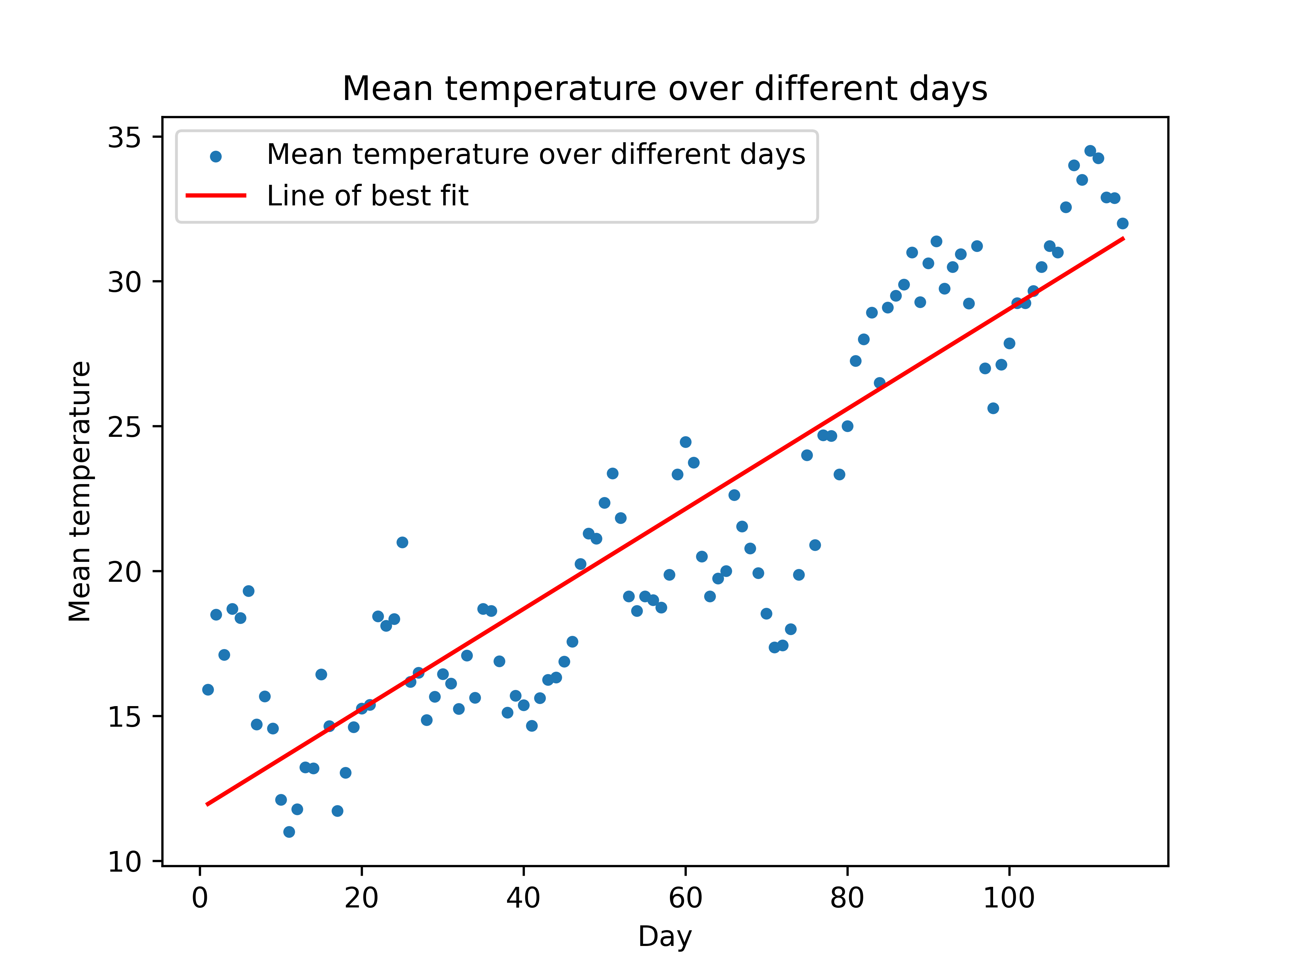
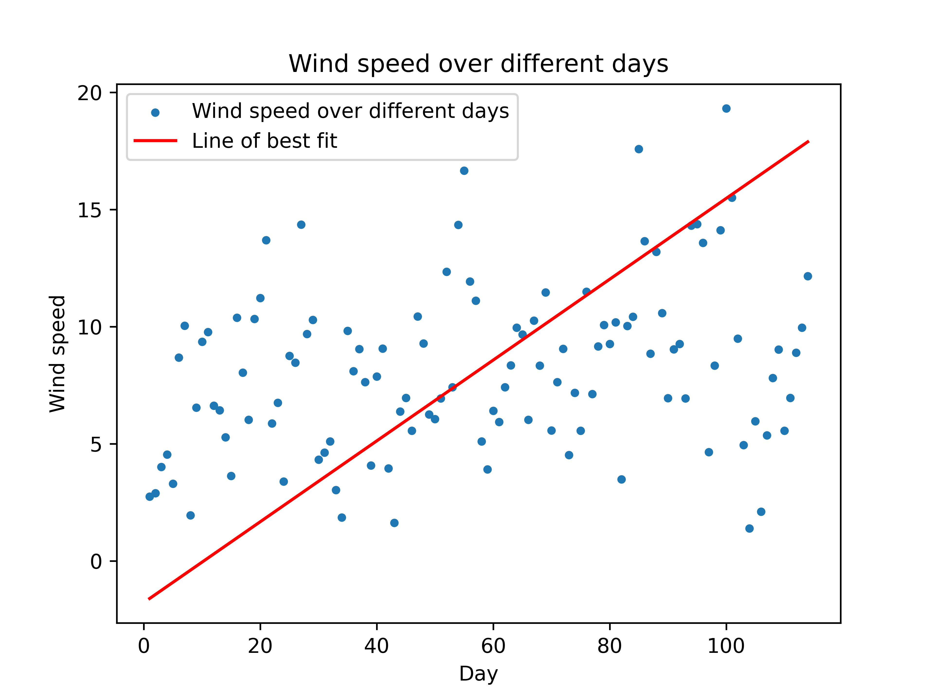
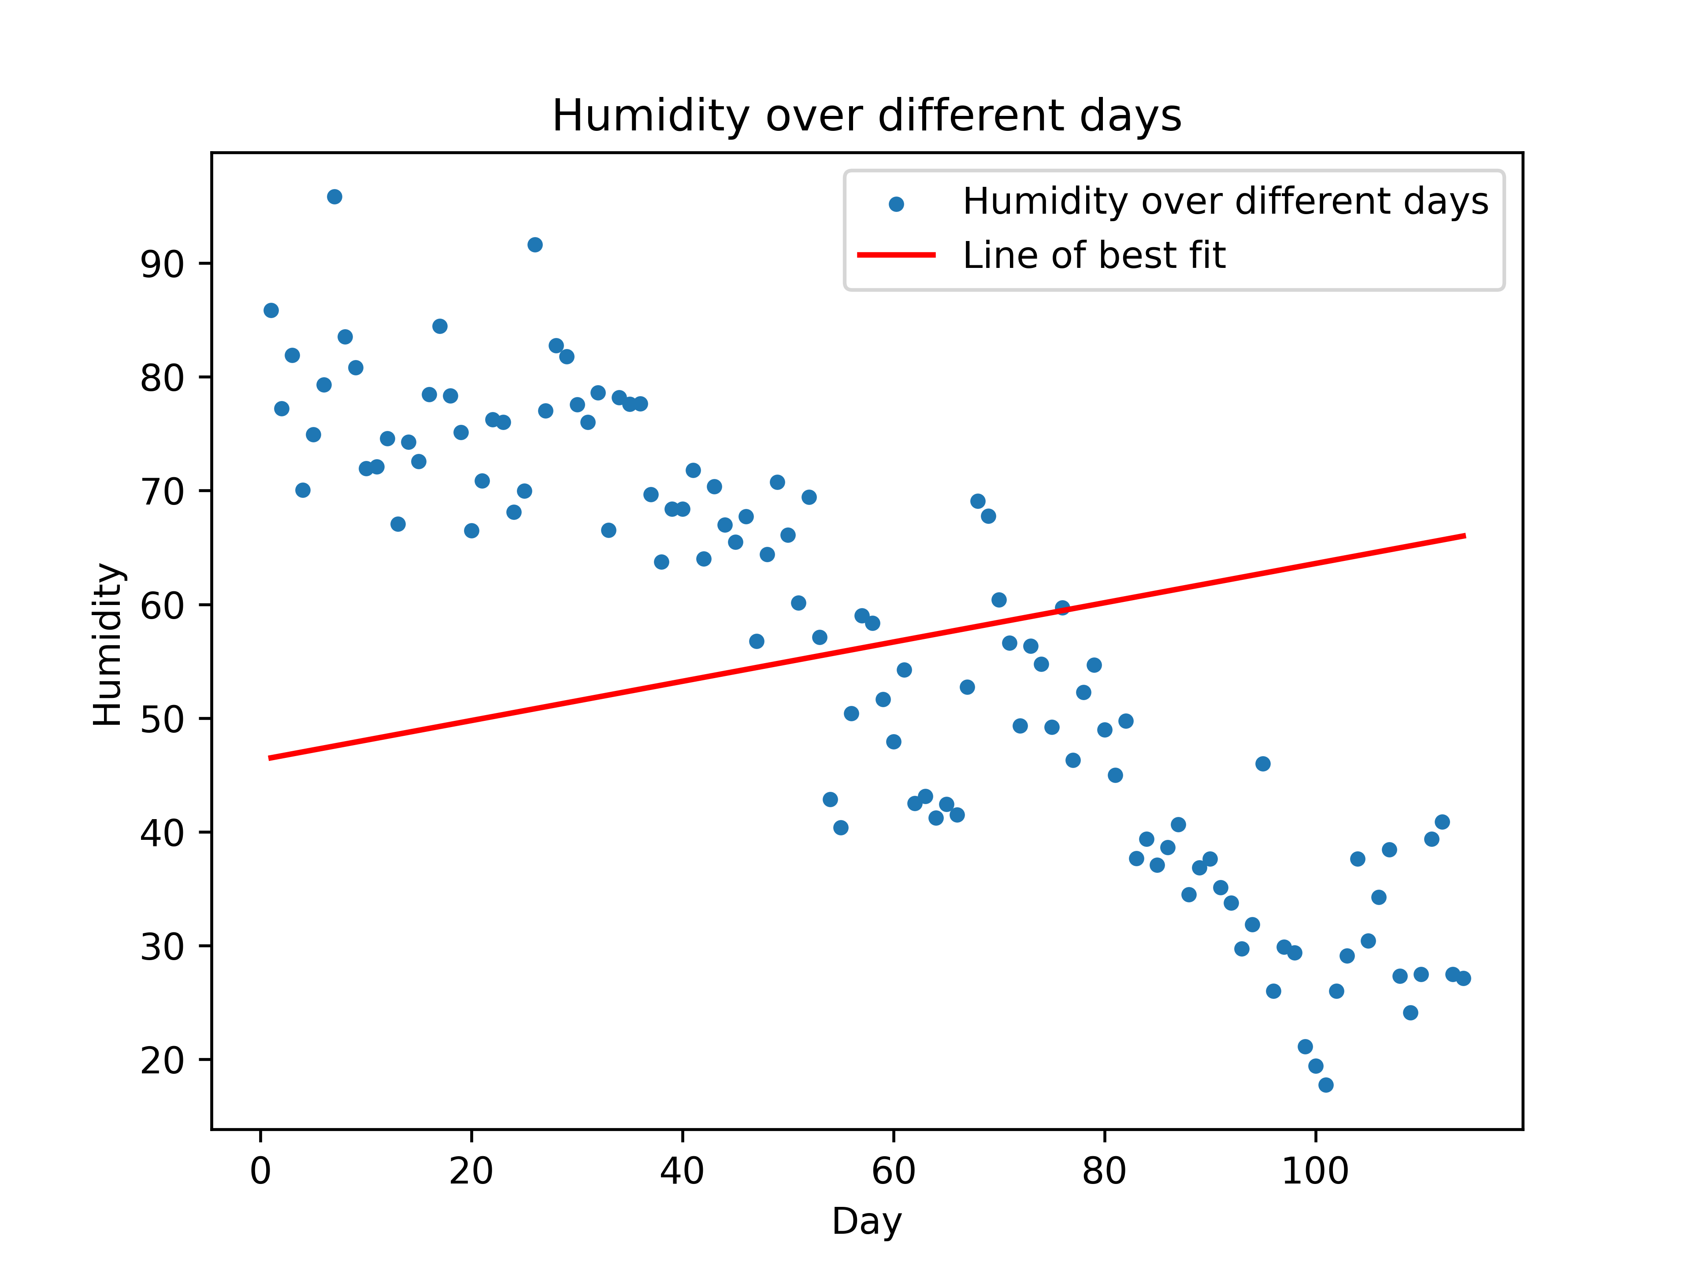
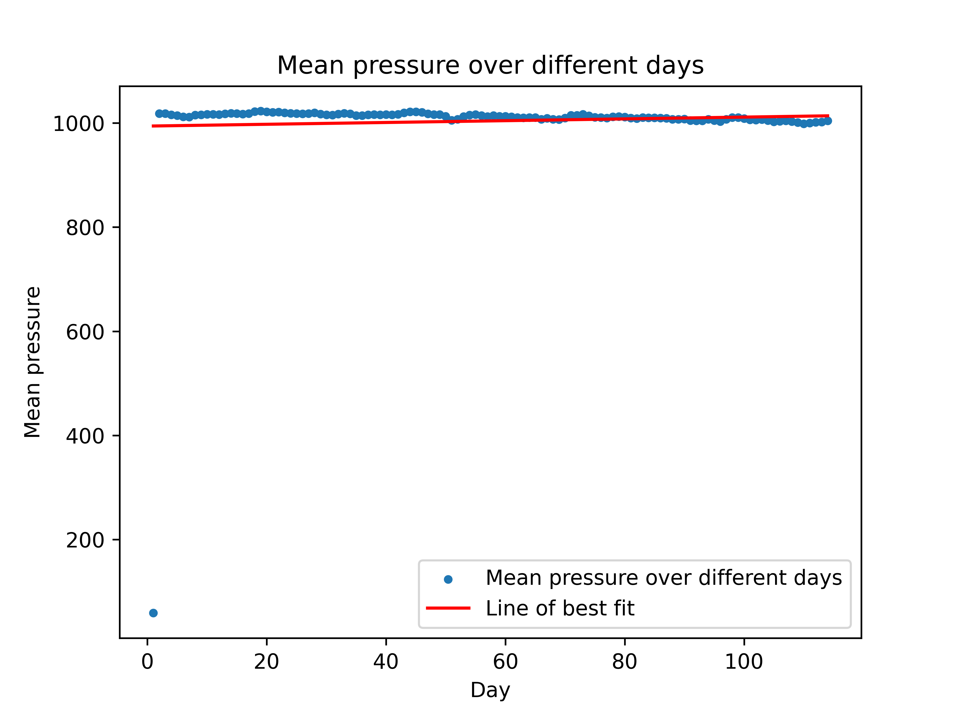
Graphs of Regression on Climate Dataset

Slide 4
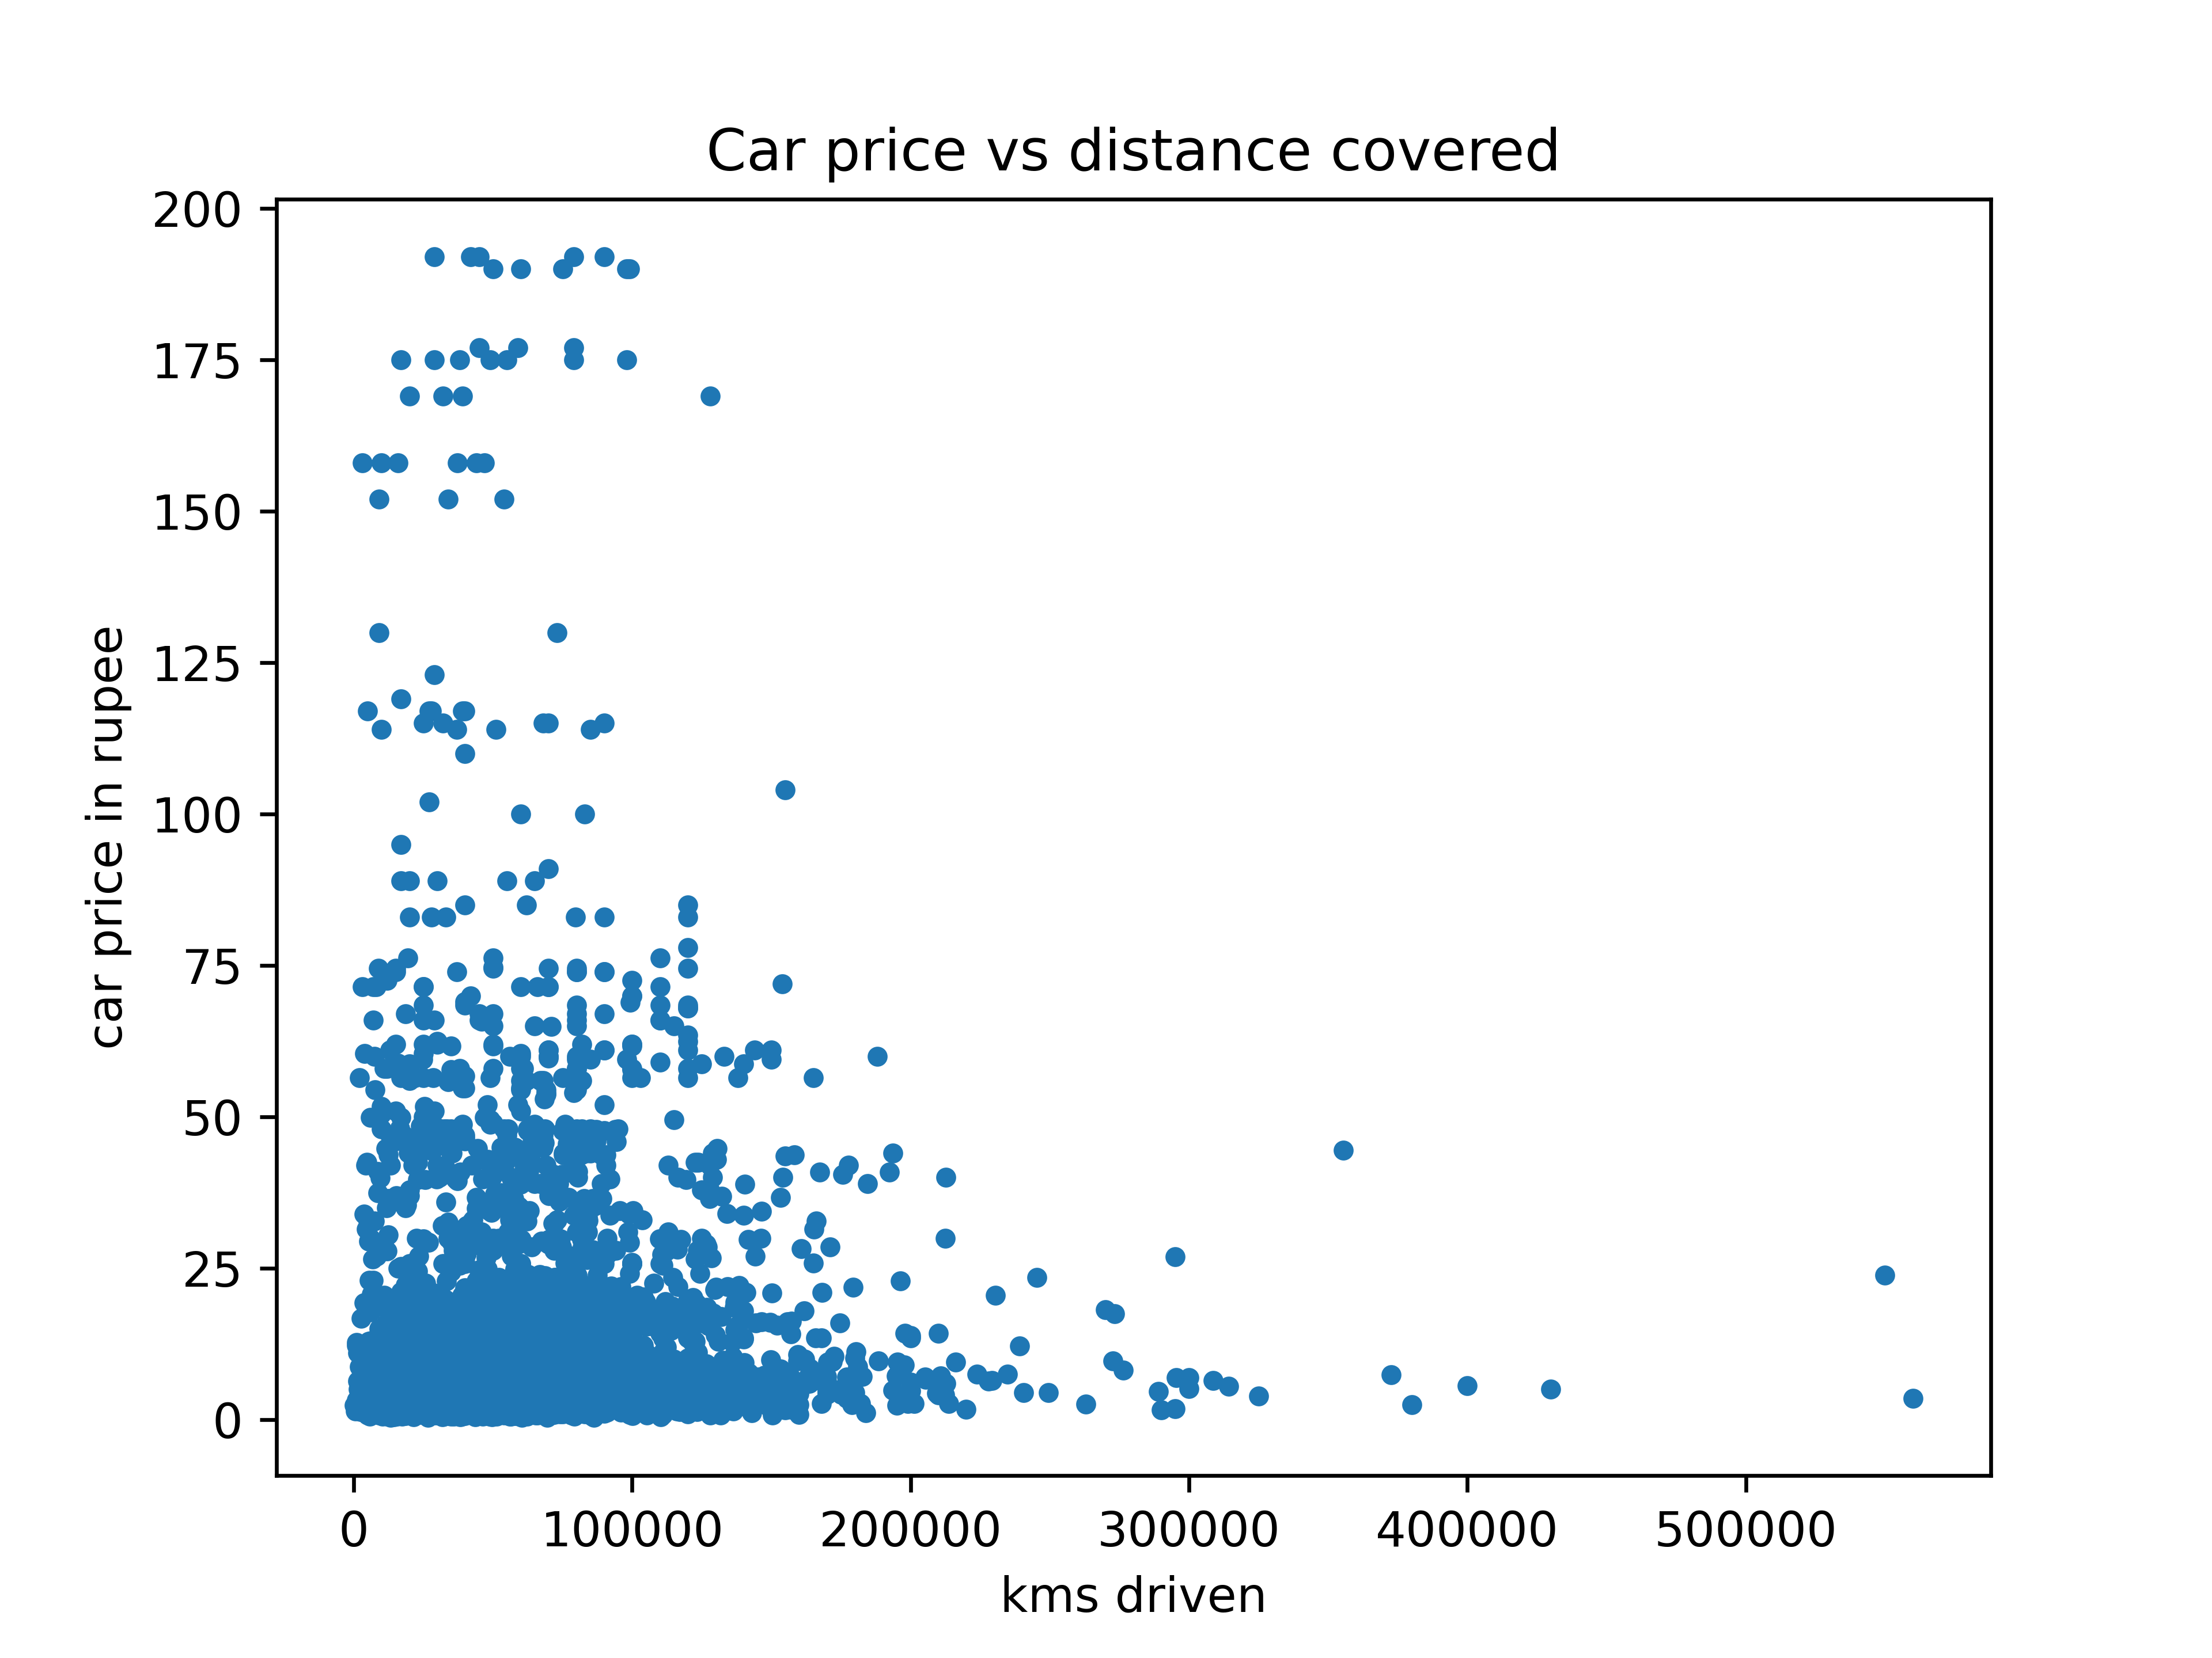
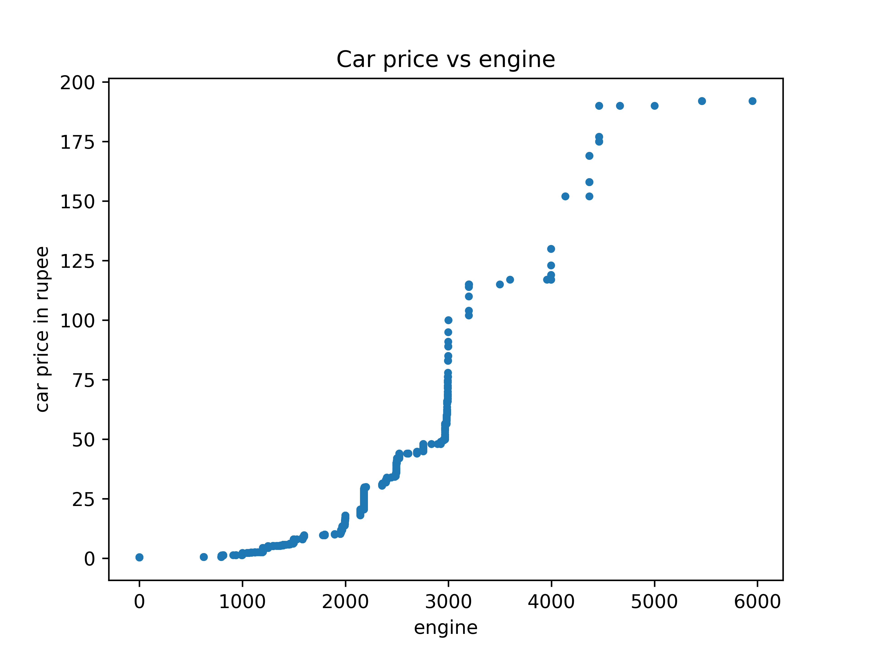
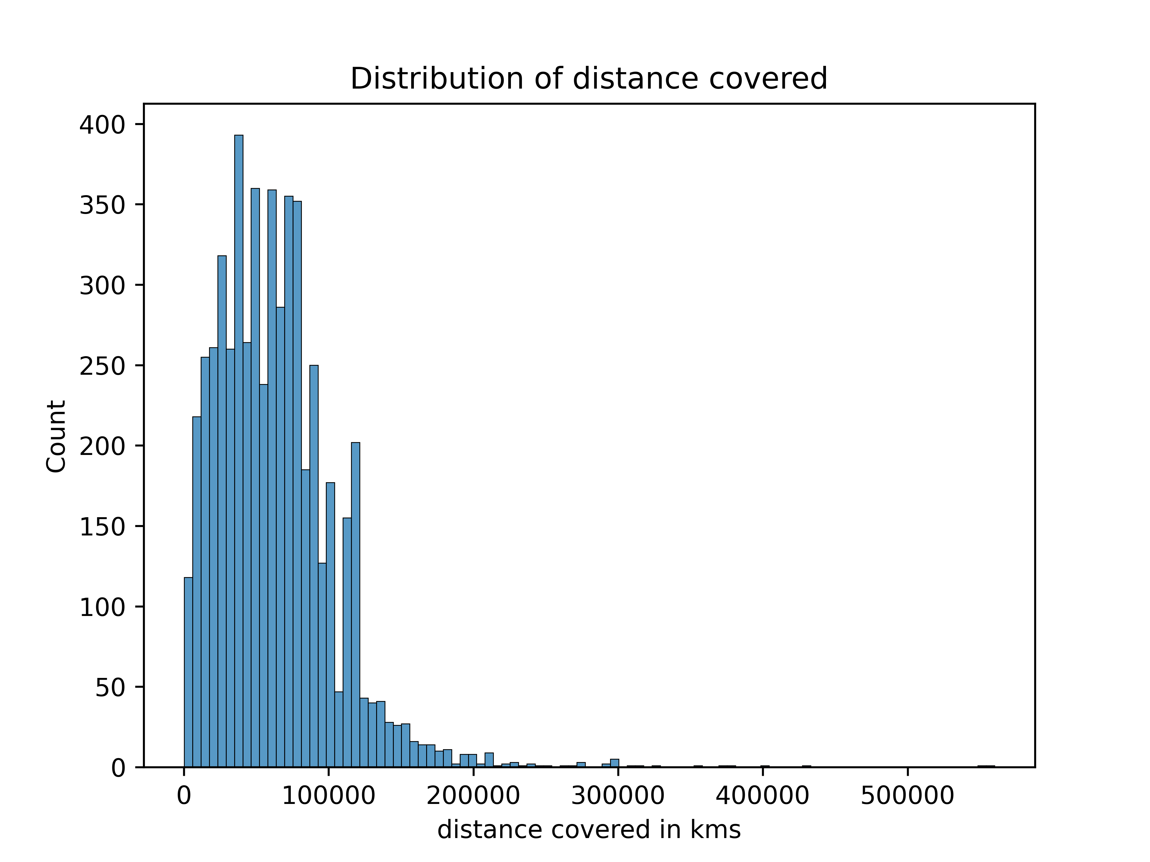
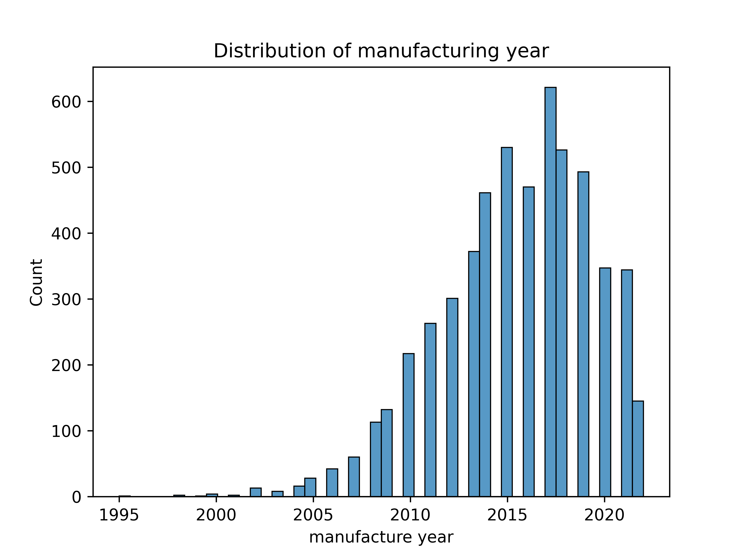
Graphs of EDA on Car Price Dataset

Slide 5
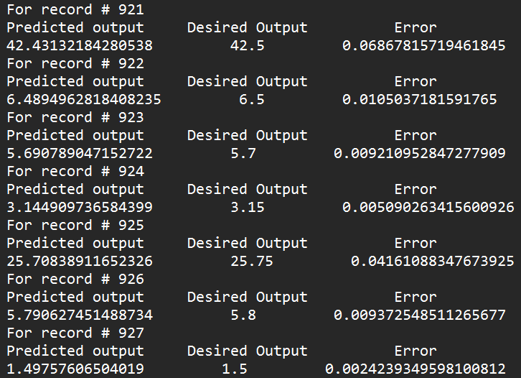
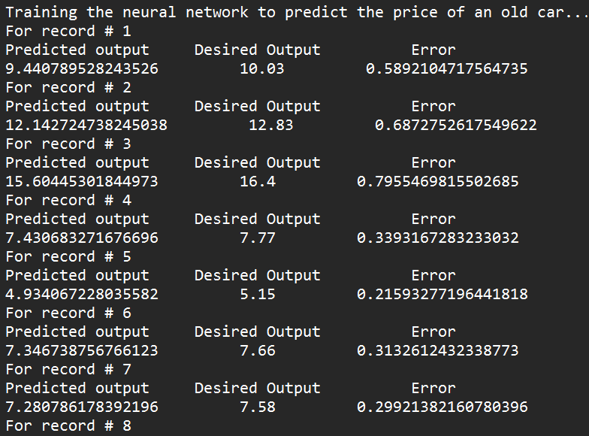
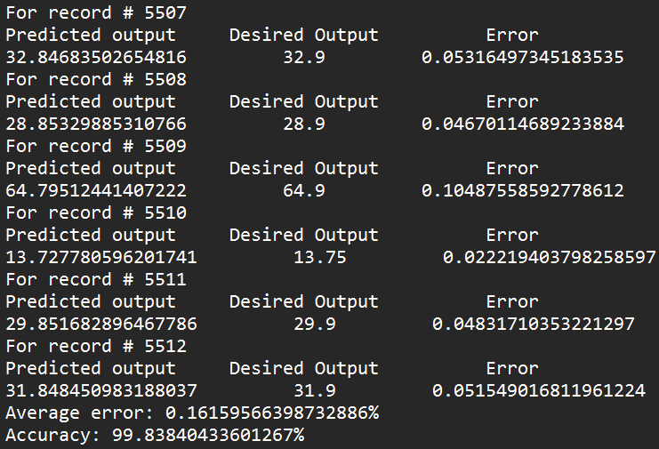
Output of Neural Network Training

Slide 6
Feature Engineering by Domain Knowledge
Merged input and output features on a given time-series data.
Learnt efficient use of pandas library functions.
Built linear regression model by splitting into training and testing sets.
Performed detailed EDA on the finally prepared dataset.
Tested the impact of various feature scaling methods on model’s accuracy.
Quantile Transformer gave the least values of MSE, RMSE, and hence the best performance.

Slide 7
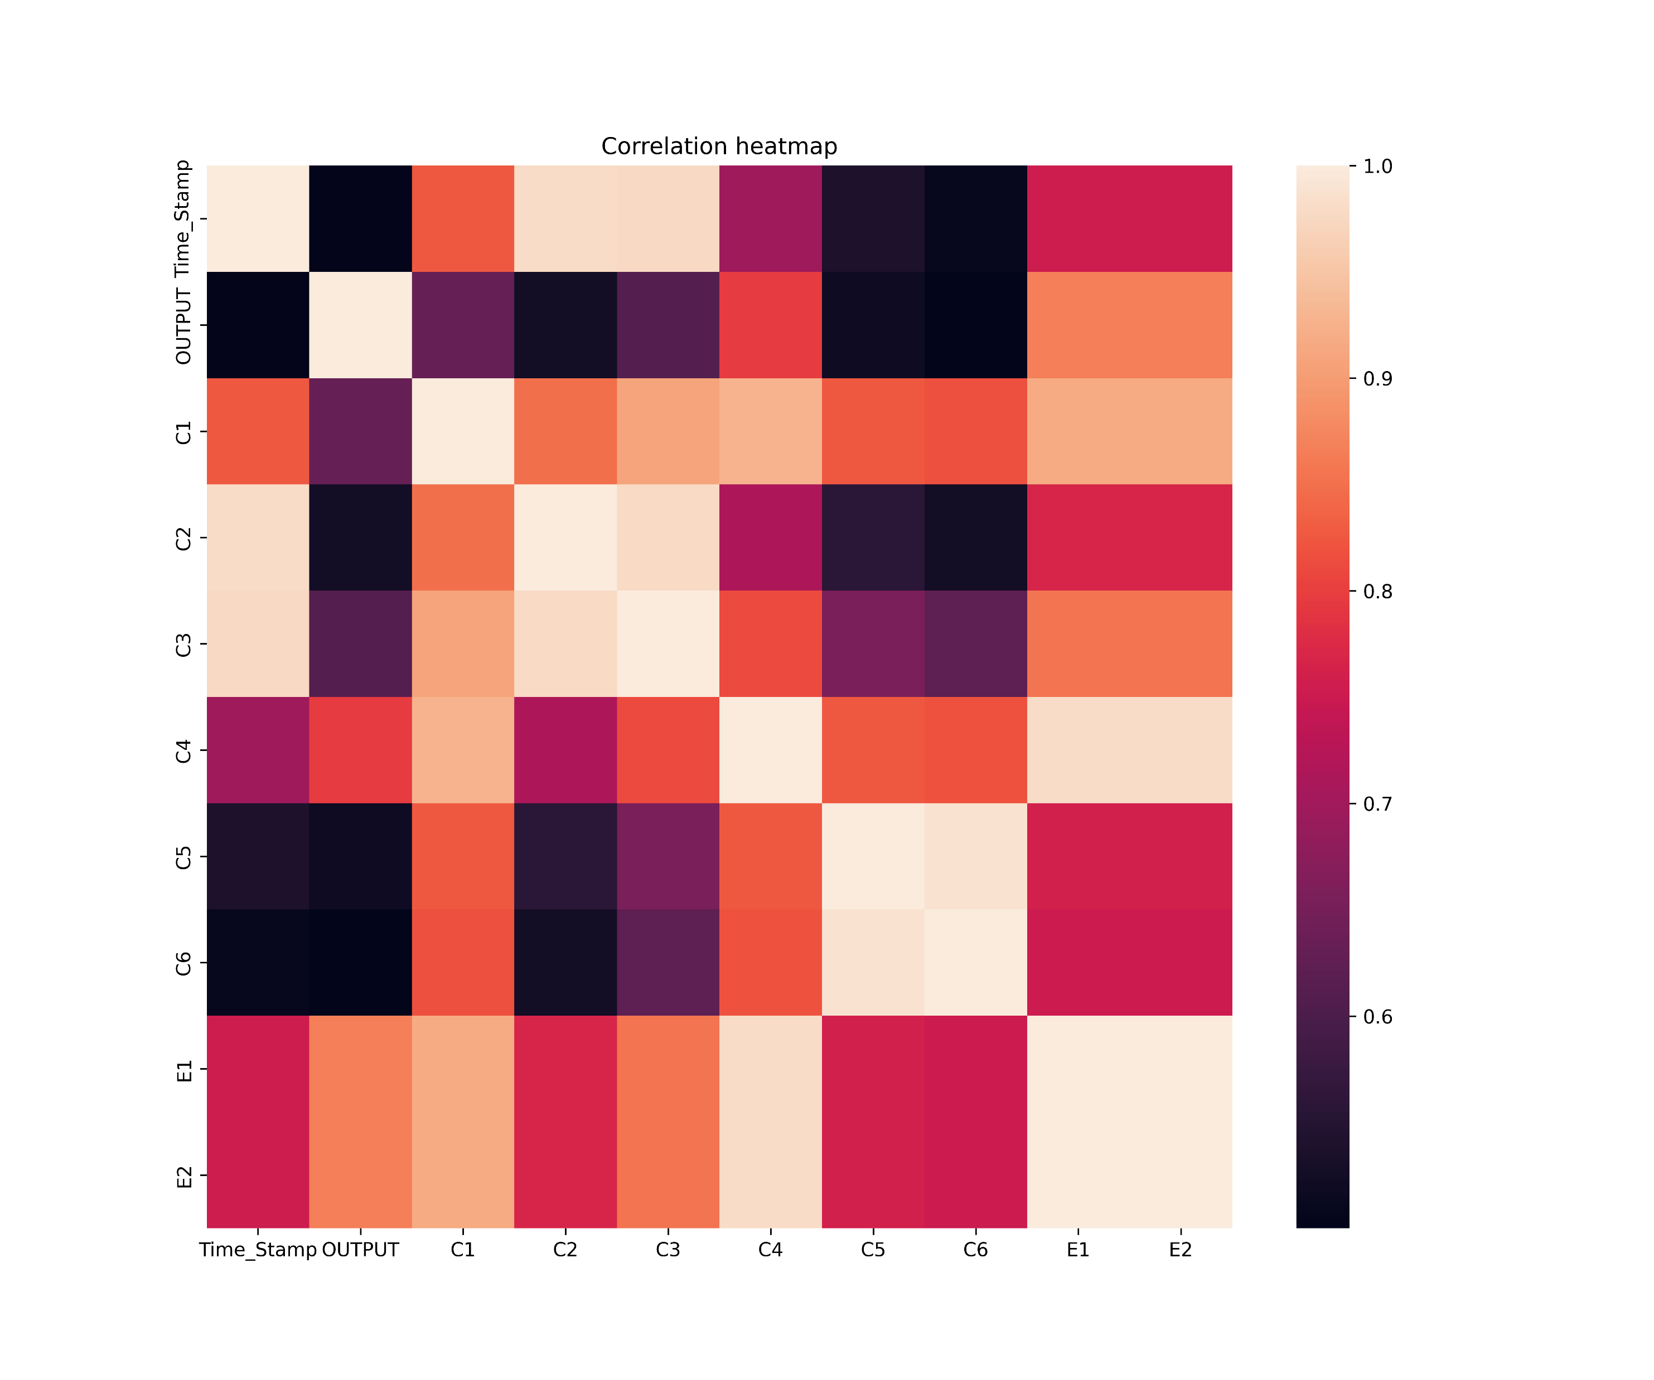
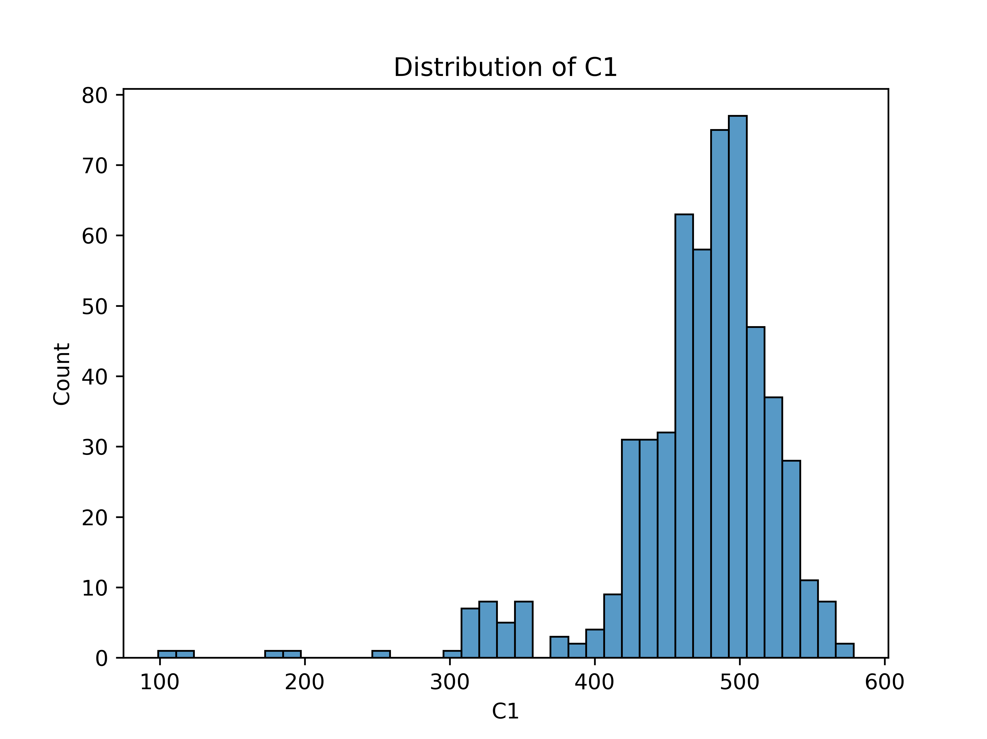
Some Recorded Graphs

Slide 8
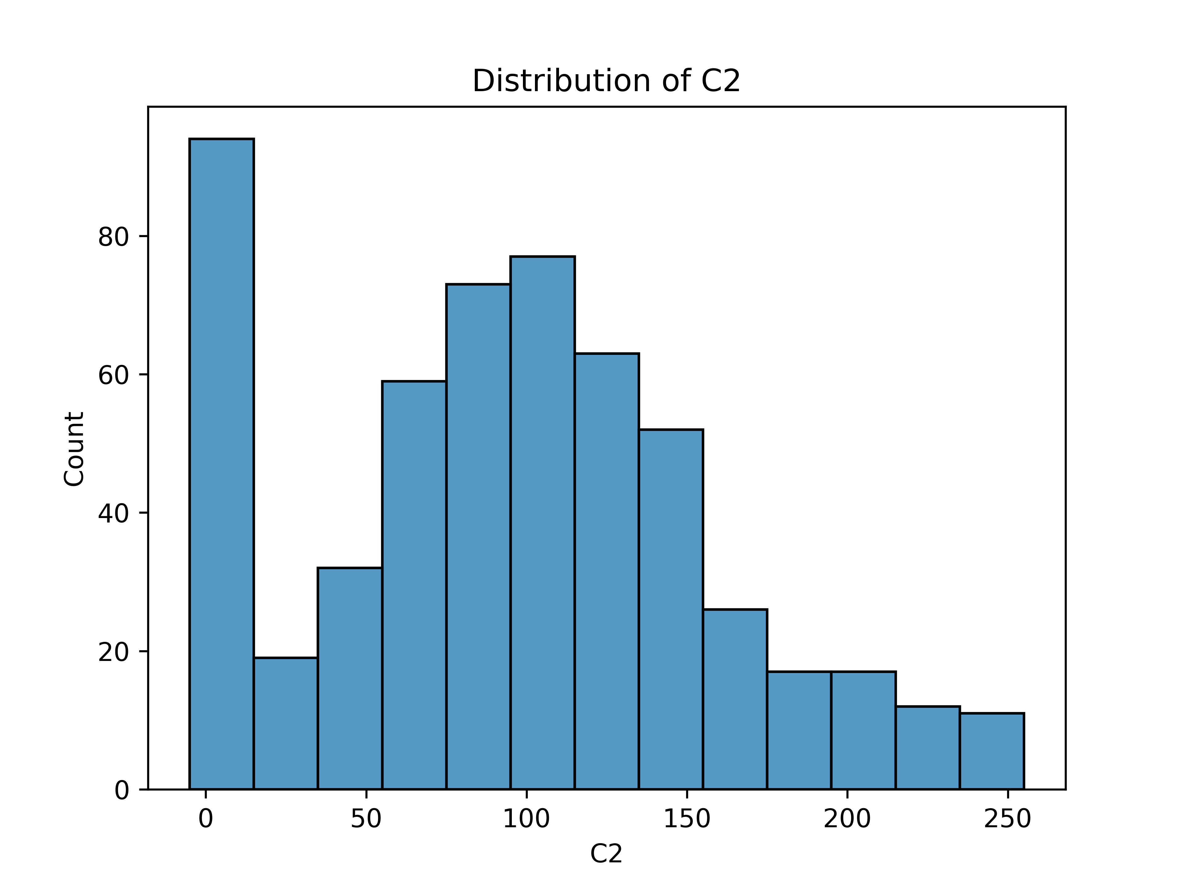
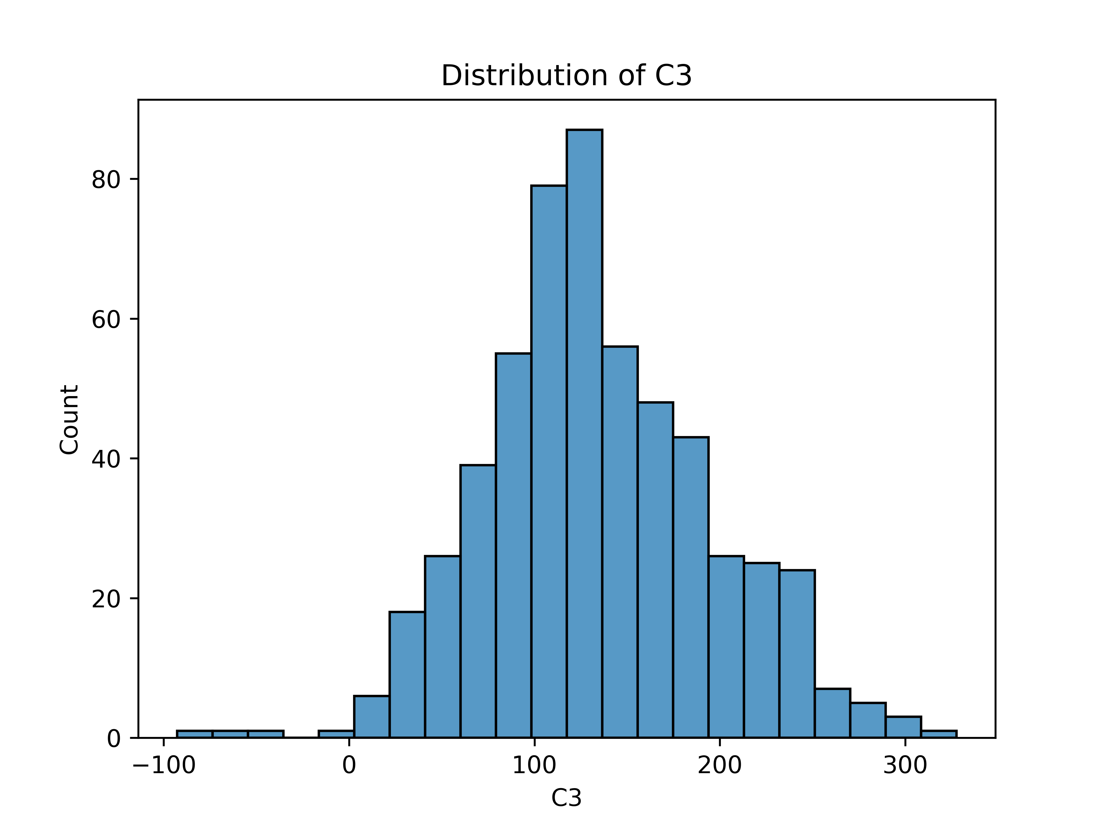
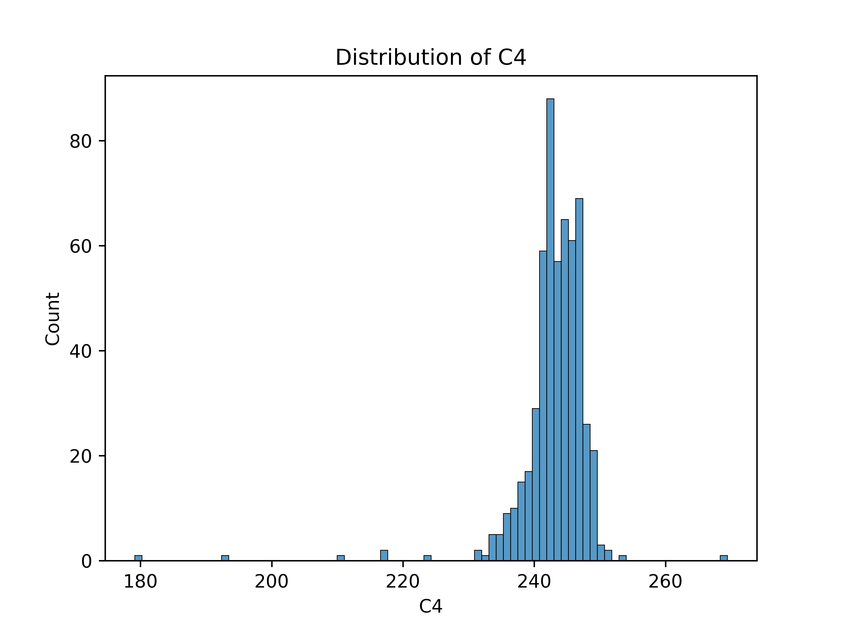
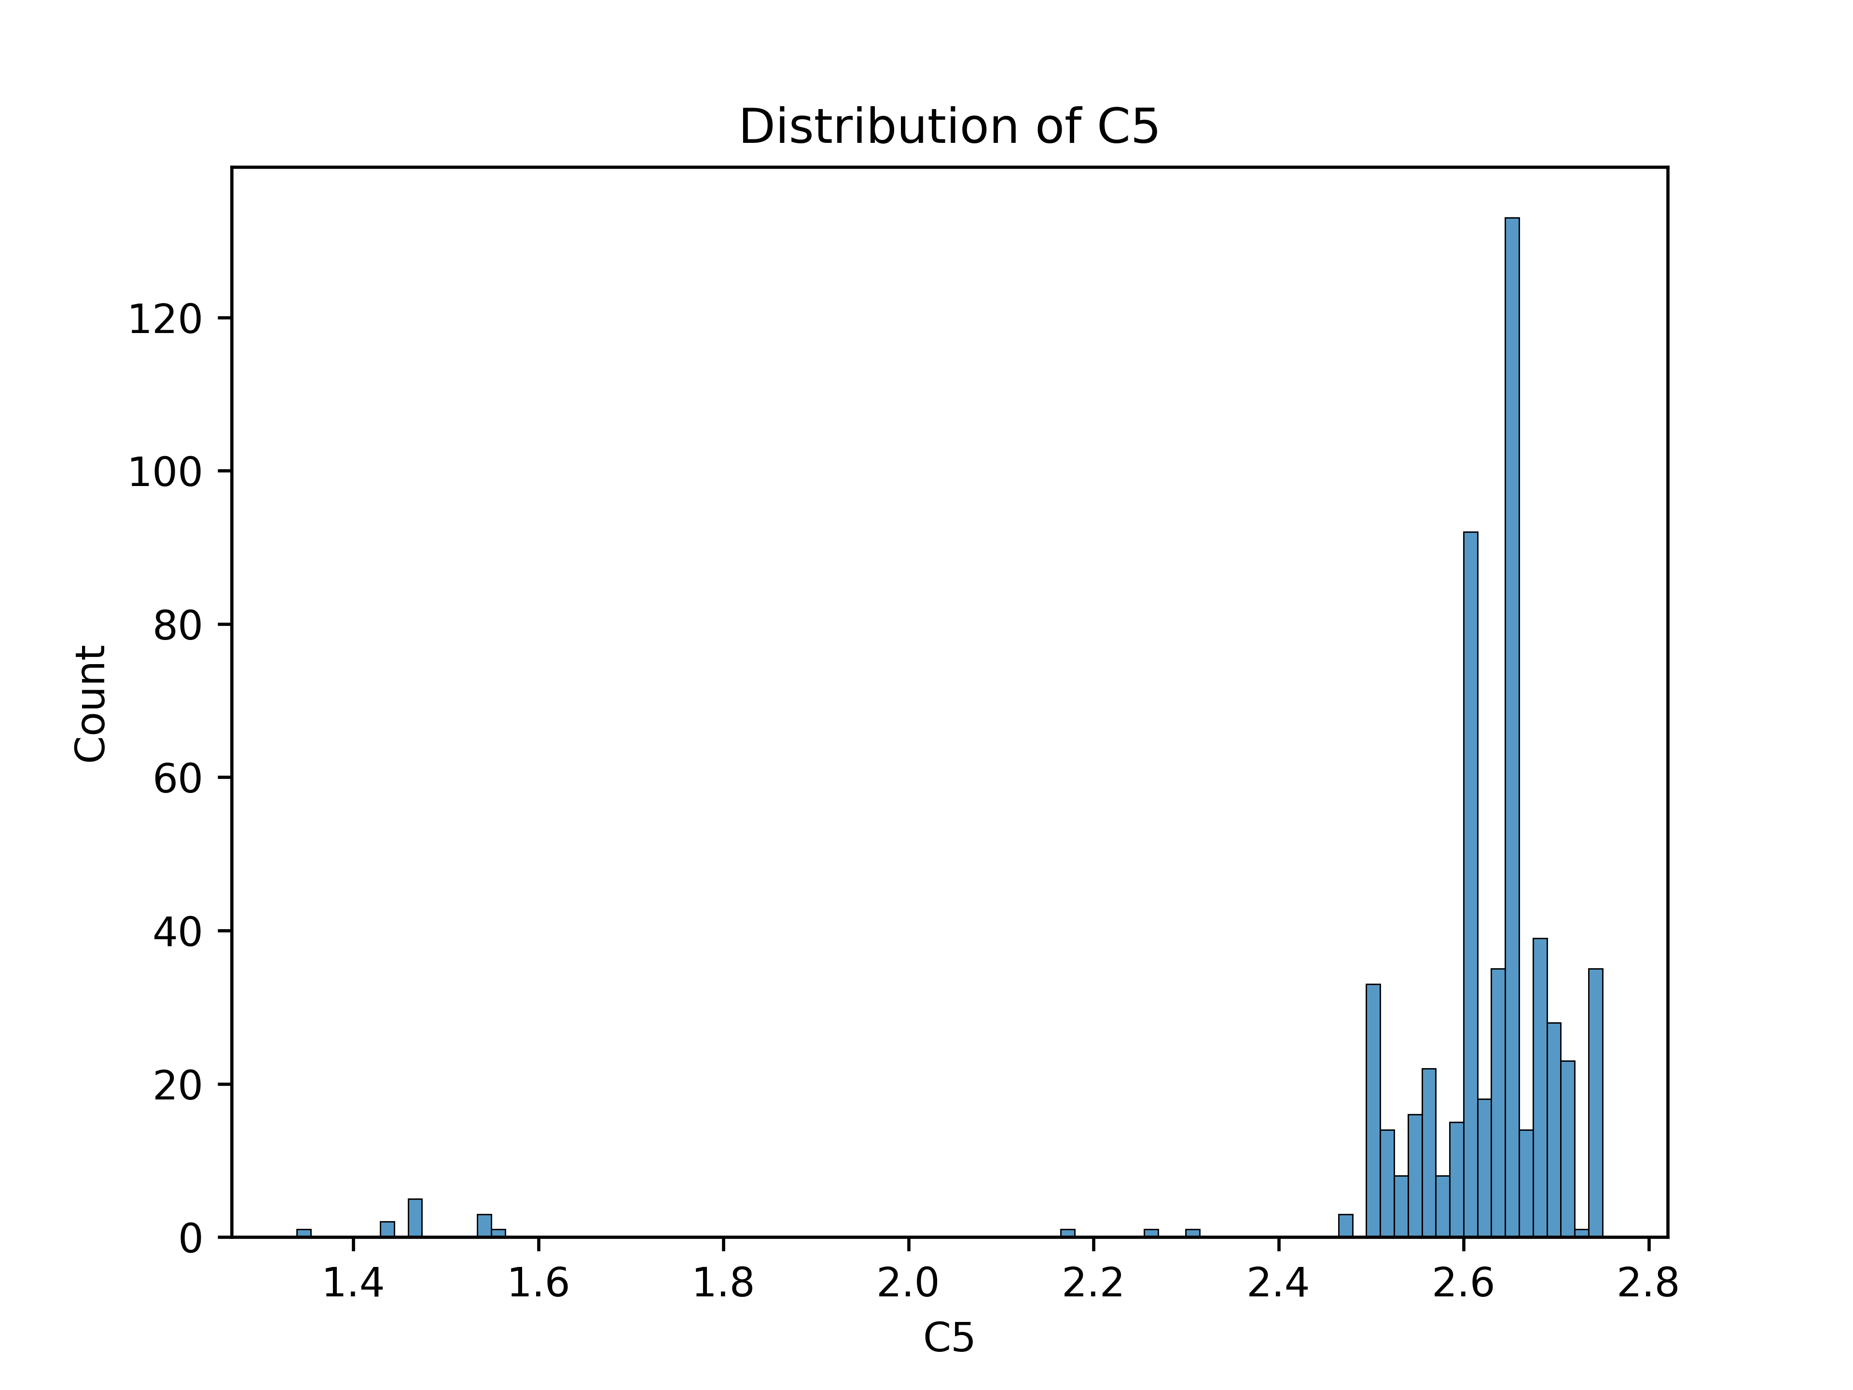
Some Recorded Graphs

Slide 9
Feature Selection
Researched over implementation of Genetic Algorithms (GA) for selecting useful features from a dataset.
Identified problems of GA’s feasibility on large datasets – computationally complex, does not guarantee optimal solution, fitness scaling problems, bias in crossover schemes, etc.
Found research papers from IEEE for other hybrid algorithms involving GA to solve feature selection problem.

Slide 10
Feature Selection (FS) Methods in ML
Filter methods:
Computationally fast and inexpensive
Good for removing redundant features – each feature being individually evaluated
Do not remove multicollinearity – poor results when a combination of features can improve model’s accuracy
Wrapper methods:
Computationally more expensive than filter methods
Provide optimal set of features => better accuracy
Greedy algorithms that use a subset of features in iterative way
Embedded methods:
Alleviate the drawbacks of filter and wrapper methods, and merge their advantages
Consider a combination of features
Faster and more accurate than filter methods

Slide 11
Filter Methods
Information gain
Chi-square test
Fisher’s score
Correlation coefficient
Variance threshold
Mean Absolute Difference
Dispersion ratio
Mutual dependence

Slide 12
Wrapper Methods
Forward selection
Backward elimination
Bi-directional elimination
Exhaustive selection
Recursive elimination
Embedded Methods
Regularization
Tree-based methods

Slide 13
Progress in FS Domain
Eventually developed a package to provide functionality of different FS methods.
Each functions accepts a pandas dataFrame, name of output feature, a choice of excluding “datetime” data type features, and number of features to select.
Each function returns a dictionary of selected features and their relative importance in % among all features in consideration.

Slide 14
Automated FS via Flask
Designed a web interface using APIs enabling various functionalities like:
Dataset upload form,
Feature selection form,
Features and their importance presented in a table, can be sorted by different columns.
In-depth EDA report accessible on web and downloadable,
Function of plotting and downloading graphs between desired features.
Error handling if some form inputs are missed.

Slide 15
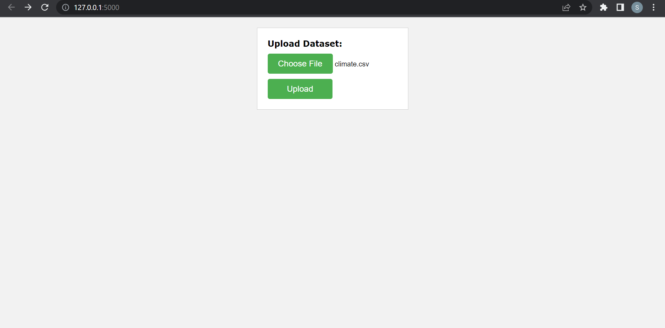
Webpages

Slide 16
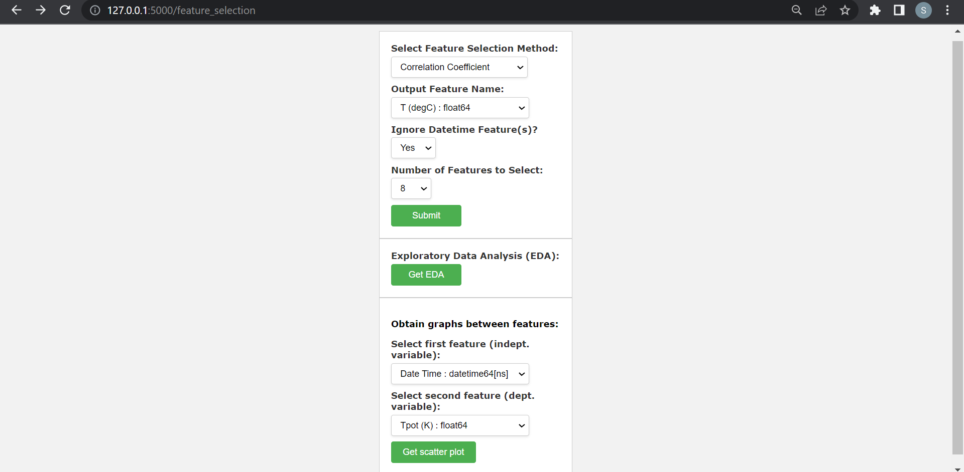
Webpages

Slide 17
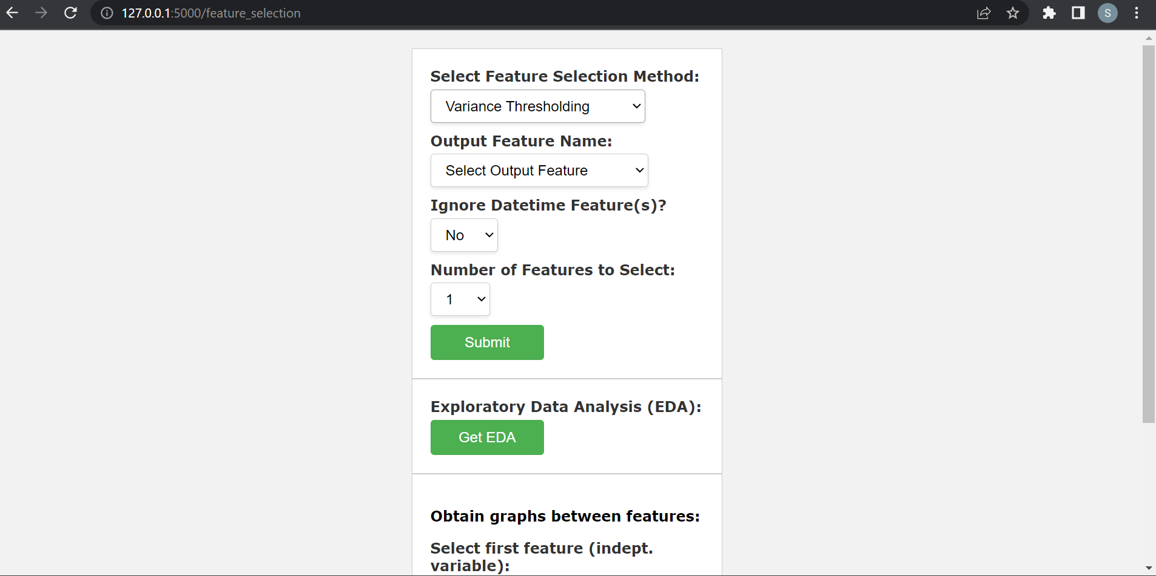
Webpages

Slide 18
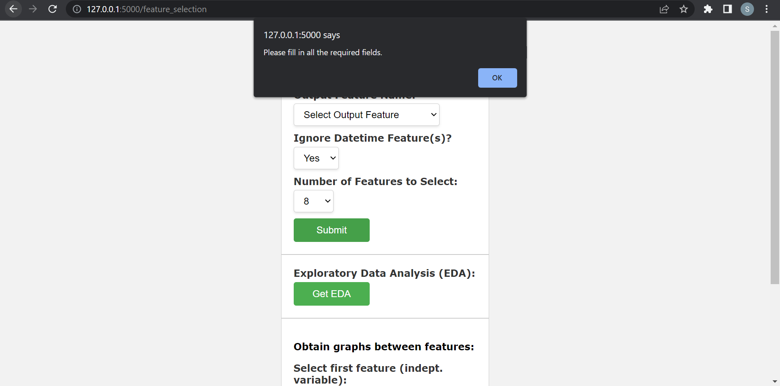
Webpages

Slide 19
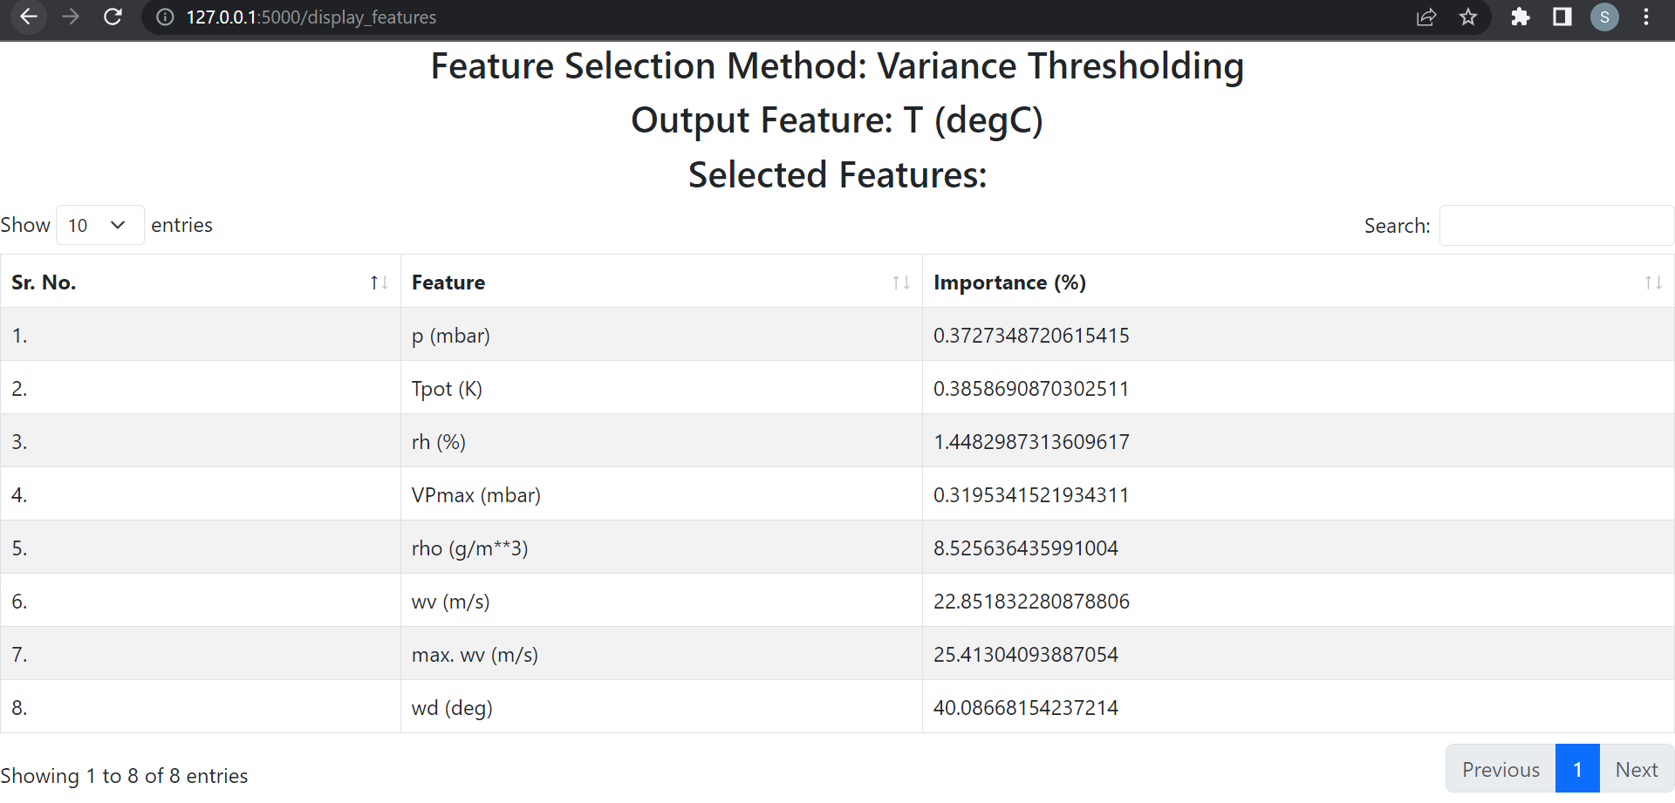
Webpages

Slide 20
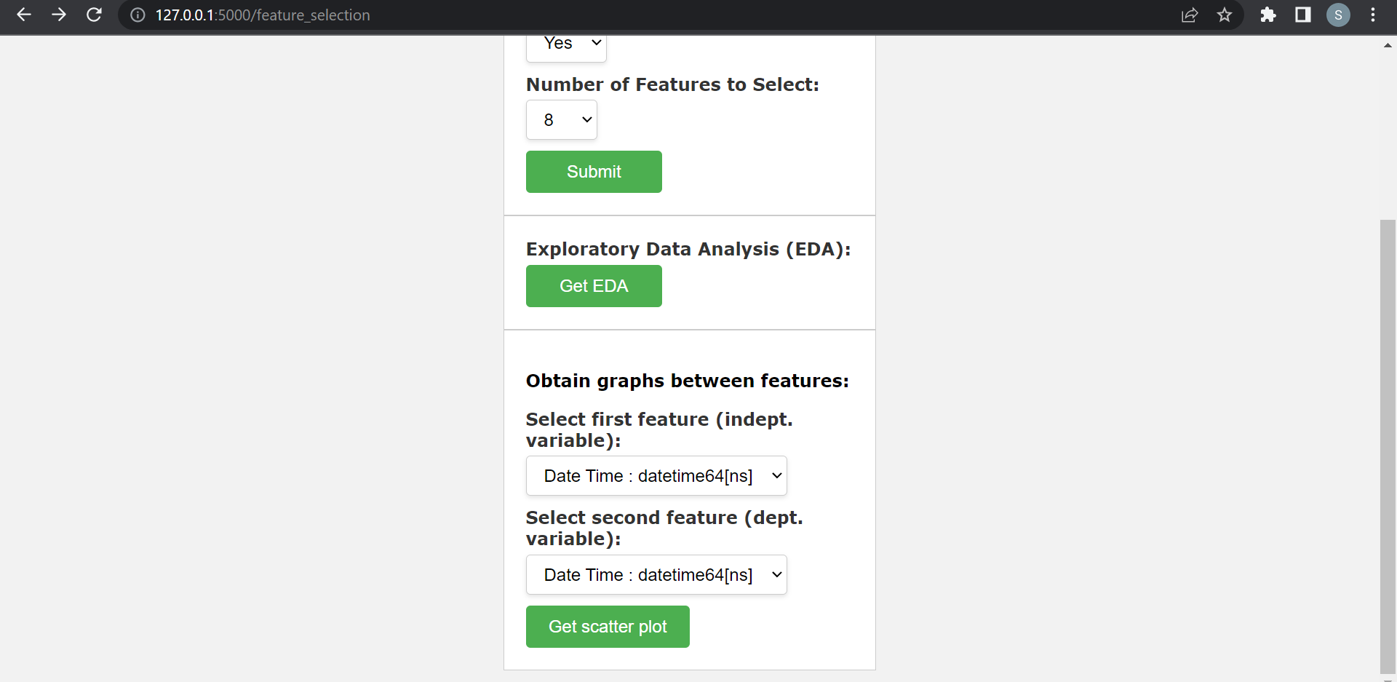
Webpages

Slide 21
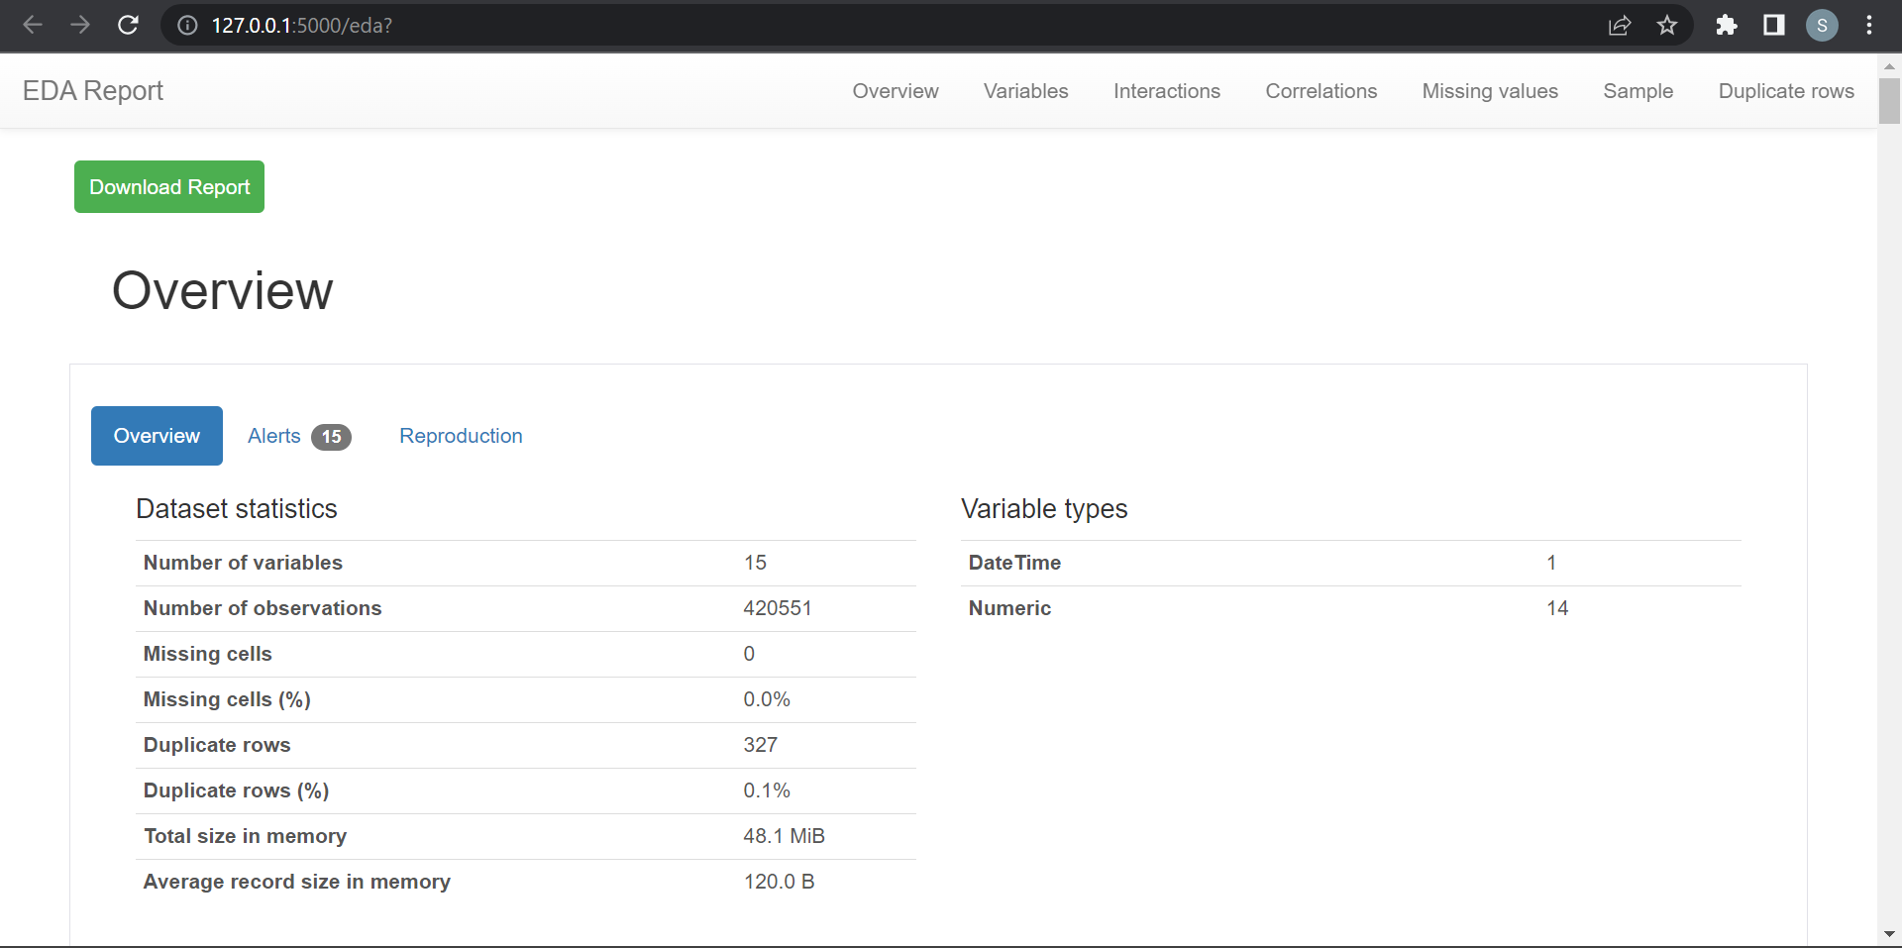
Webpages

Slide 22
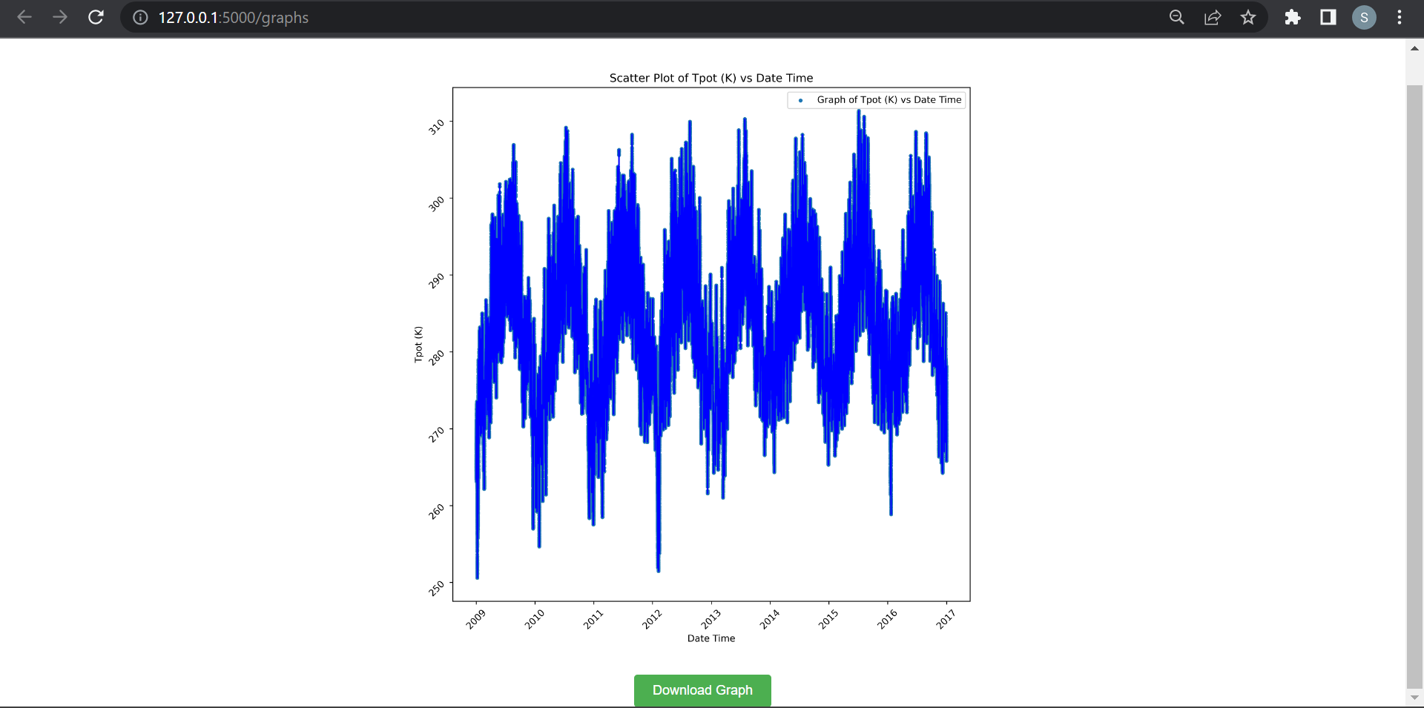
Webpages

Slide 23
Exposure of Skills
Flask (new)
pandas, sklearn, numpy, matplotlib
Feature Engineering in ML (new)
Creating APIs (new)
Javascript (somewhat new)
HTML
CSS
Python (somewhat new)
Bootstrap (somewhat new)
jQuery (new)
Improvement in code debugging

Slide 24
Thank You

